Slide 1
About Python Complete
Copyright © 2022 by Elephant Scale, All Rights Reserved

Slide 2
Week 1
 | Day | Subject
 | Monday | Python installation and basics
 | Tuesday | Python data structures
 | Wednesday | Libraries, File reading and writing
 | Thursday | SQL, Databases with Python
 | Friday | Web programming
Copyright © 2022 by Elephant Scale, All Rights Reserved

Slide 3
Week 2
 | Day | Subject
 | Monday | Pandas
 | Tuesday | NumPy and SciPy
 | Wednesday | Scikit-Learn
 | Thursday | Spark, PySpark, and Databricks
 | Friday | Machine learning and AI
Copyright © 2022 by Elephant Scale, All Rights Reserved

Slide 4
Pre-requisites for Python Class
No Python knowledge is assumed (but may be helpful)
Some software development experience (languages, databases, ...)
Have a Python development environment
We will set this up in class
Curiosity!
Ask a lot of questions
This is an intro-intermediate class.
Copyright © 2022 by Elephant Scale, All Rights Reserved

Slide 5
Our Teaching Philosophy
Emphasis on concepts & fundamentals
No need to memorize any API
Highly interactive (questions and discussions are welcome)
Hands-on (learn by doing)
Copyright © 2022 by Elephant Scale, All Rights Reserved

Slide 6
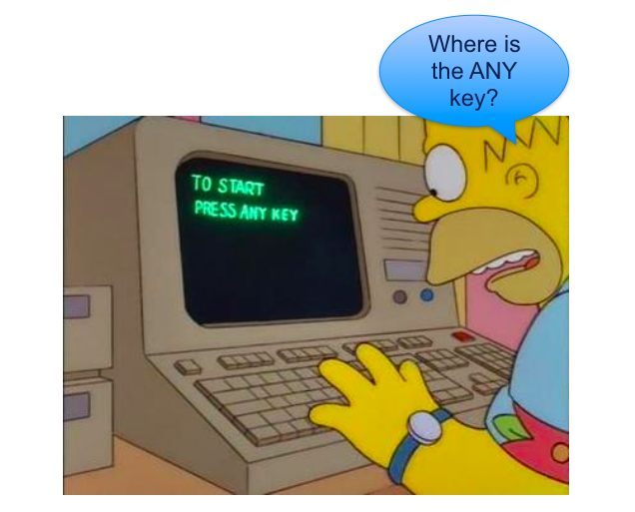
Lots of Labs: Learn By Doing
Where is the ANY key?
Copyright © 2022 by Elephant Scale, All Rights Reserved

Slide 7

Analogy: Learning To Fly...
Copyright © 2022 by Elephant Scale, All Rights Reserved

Slide 8
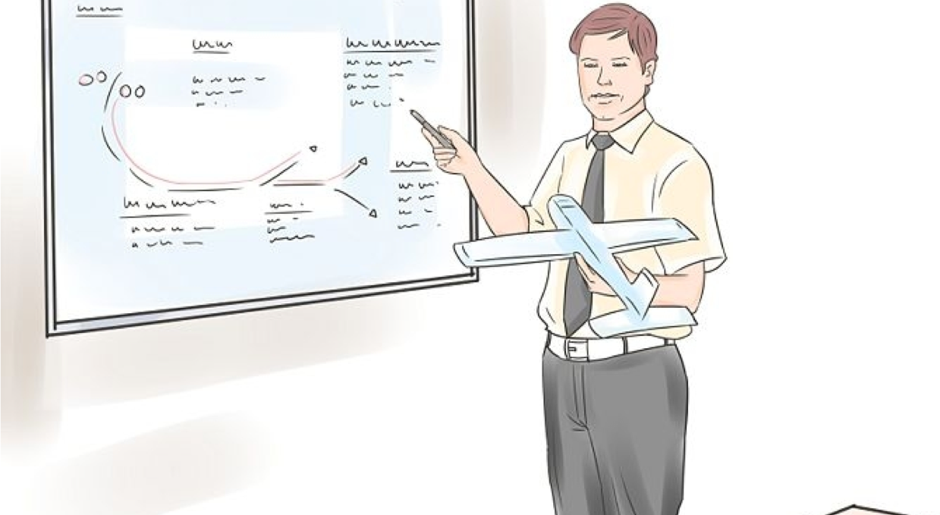
Instruction
Copyright © 2022 by Elephant Scale, All Rights Reserved
Notes:
http://aviation-schools.regionaldirectory.us/learn-to-fly-720.jpg

Slide 9
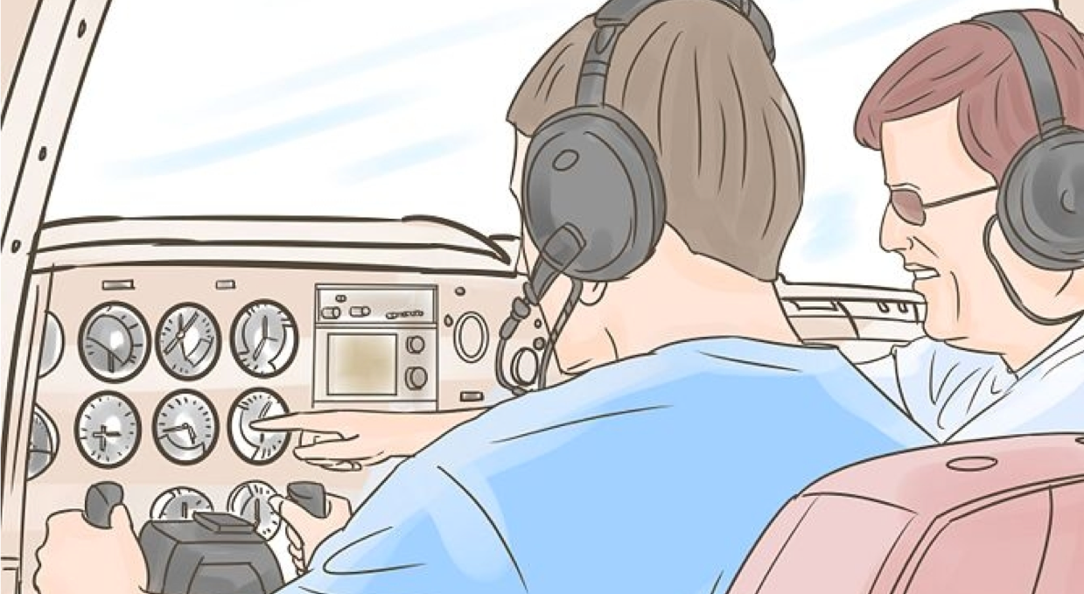
+ Flight Time
Copyright © 2022 by Elephant Scale, All Rights Reserved
Notes:
http://www.wikihow.com/Become-a-Certified-Flight-Instructor

Slide 10
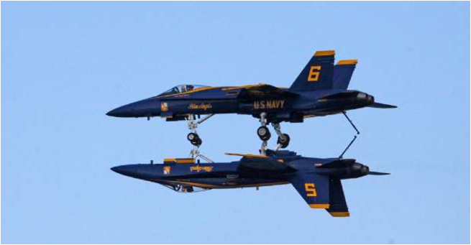
This Will Take A Lot Of Practice
Copyright © 2022 by Elephant Scale, All Rights Reserved

Slide 11

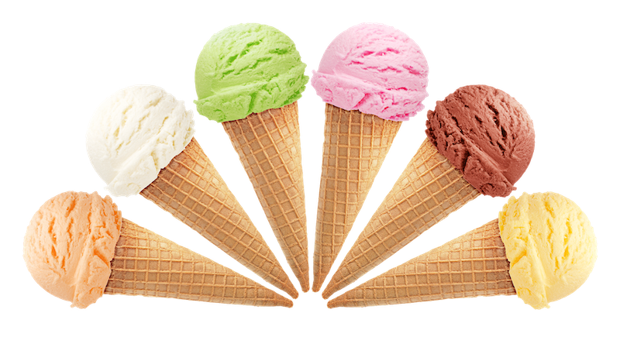
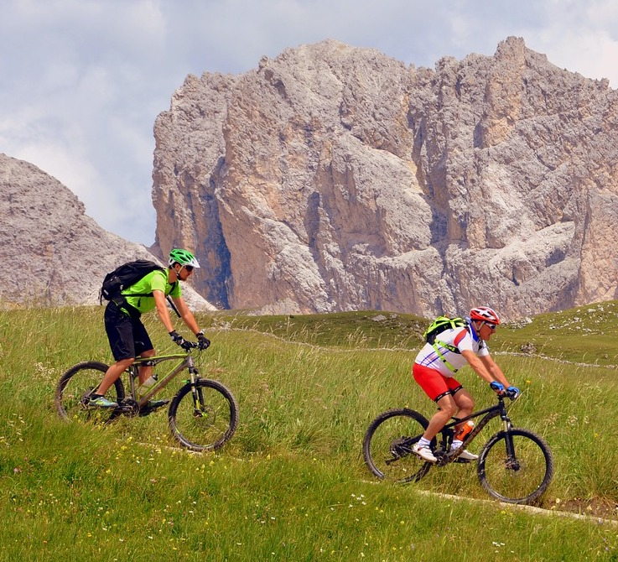
About You And Me
About Instructor
About you
Your Name
Your background (developer, admin, manager,...)
Technologies you are familiar with
Familiarity with Python (scale of 1 – 4 ; 1 – new, 4 – expert)
Something non-technical about you!(favorite ice cream flavor, hobby, etc.)
Copyright © 2022 by Elephant Scale, All Rights Reserved

